Slide 1
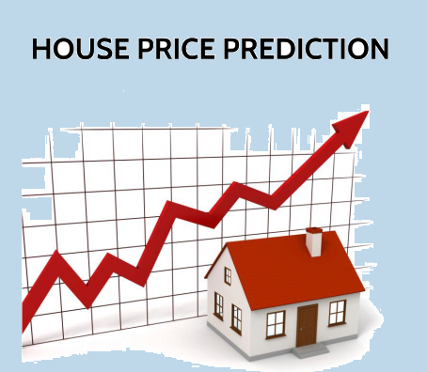
NEXTHIKE IT SOLUTIONS
Exploratory Data Analysis (EDA)
for
Real Estate Pricing

Slide 2
Exploratory Data Analysis (EDA)
EDA in real estate pricing involves investigating the dataset to uncover patterns, relationships, and outliers that might influence house prices. This process helps in understanding how different factors impact the value of a property, which can be crucial for accurate prediction and analysis. By conducting thorough EDA, data analysts can gain valuable insights into the real estate market and develop more accurate predictive models.
EDA helps us uncover hidden relationships, outliers, and trends that may be obscured at first glance, ensuring a comprehensive analysis that goes beyond surface-level observations.

Slide 3
Key Aspects of EDA in Real Estate Pricing
Data Loading and Exploration
Data Cleaning and Preprocessing
Univariate Analysis
Multivariate Analysis
Feature Engineering
Feature Engineering and Size Impact
Outlier Detection and Treatment
Visualization
Correlation Analysis
Data Transformation
Model Selection

Slide 4
Cleaning the Data
Loading and Inspecting Data
Addressing Missing Values
Handling Duplicate Data
Correcting Data Types
Addressing Outliers
Dropping unwanted Column
Renaming Columns
Aggregating and Transforming Data
Validating Results

Slide 5
Univariate Analysis
Univariate analysis is a statistical technique that examines a single variable at a time, focusing on describing its characteristics without considering relationships with other variables. It's a fundamental approach to understanding the distribution, central tendency, and variability of data.
Key aspects of univariate analysis:
Focus on a single variable
Descriptive statistics
Visualization
Purpose
Foundation for further analysis

Slide 6
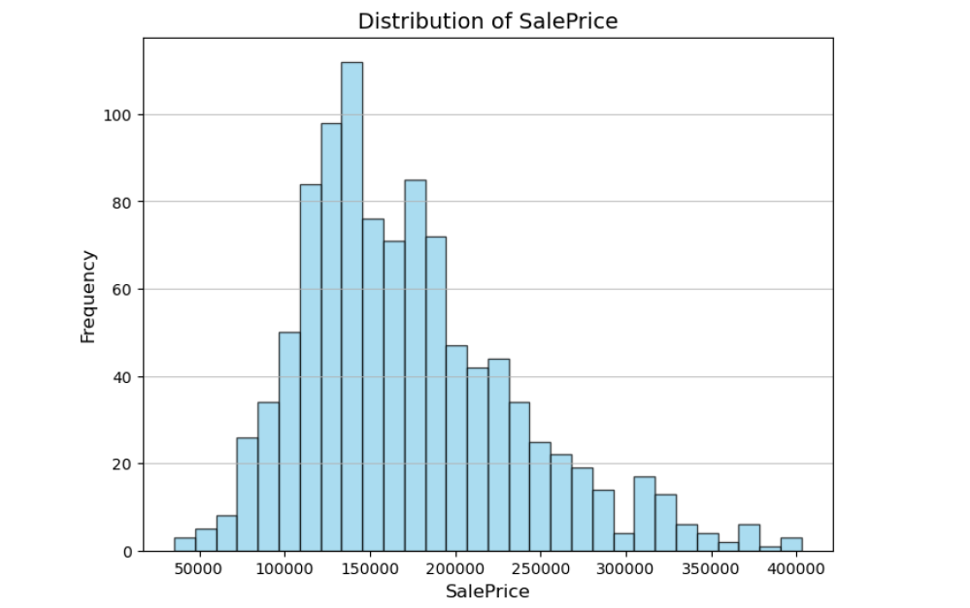
Distribution of House Sale Price

Slide 7
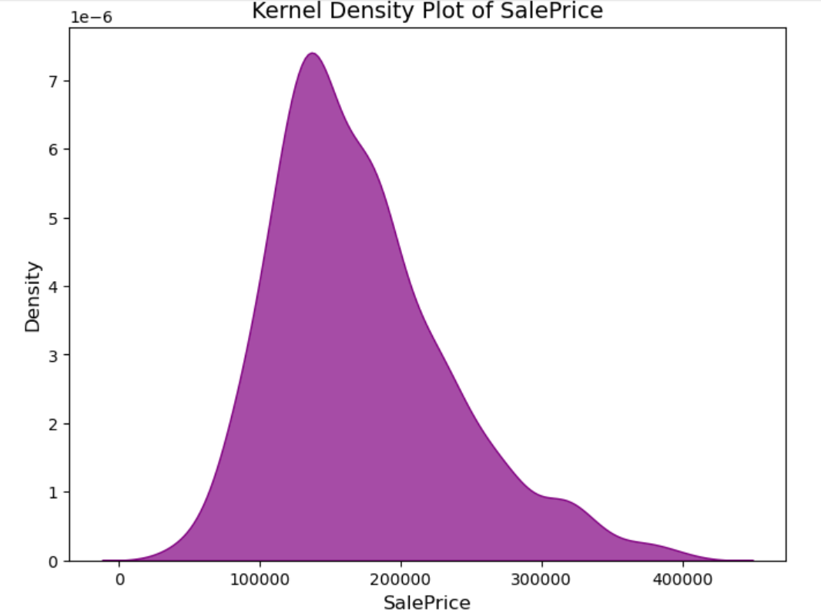
Kernel Density Plot of Sale Price

Slide 8
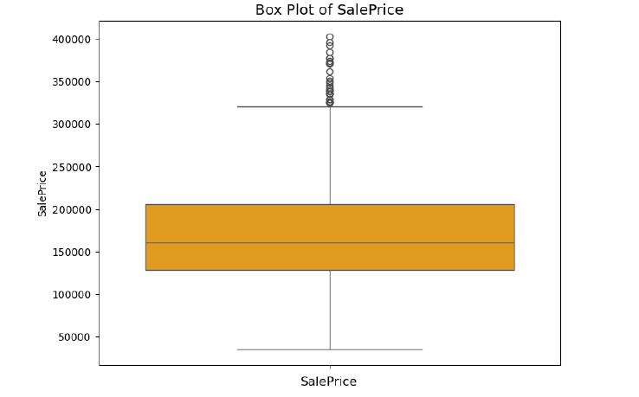
Box Plot of SalePrice

Slide 9
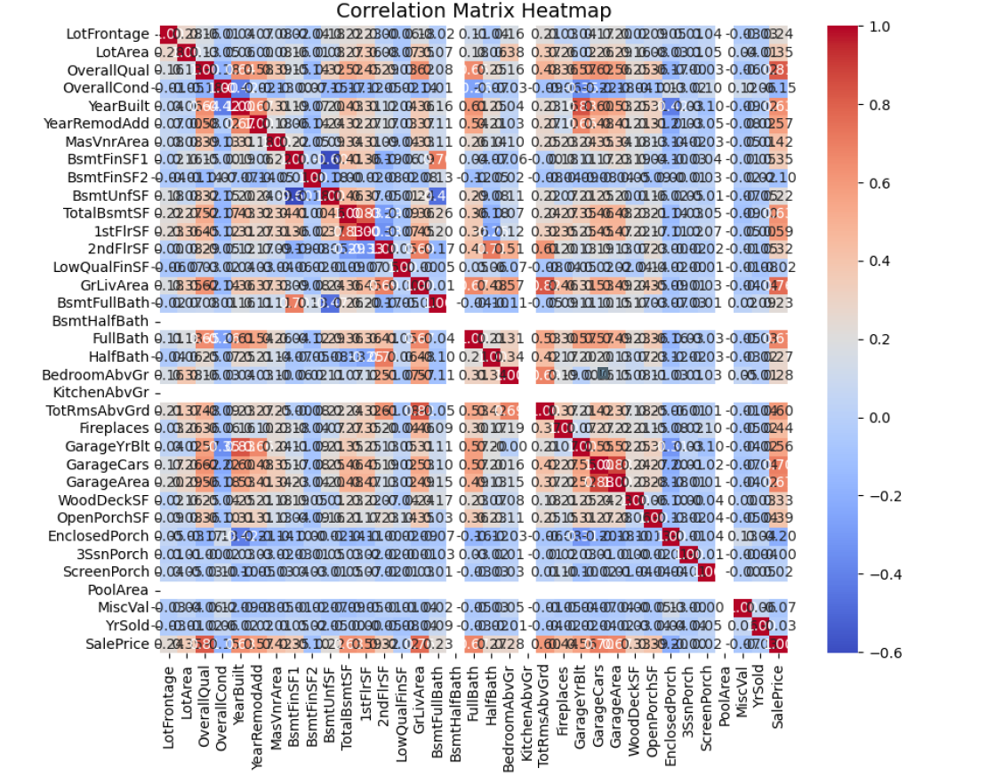
Multvariate Analysis

Slide 10
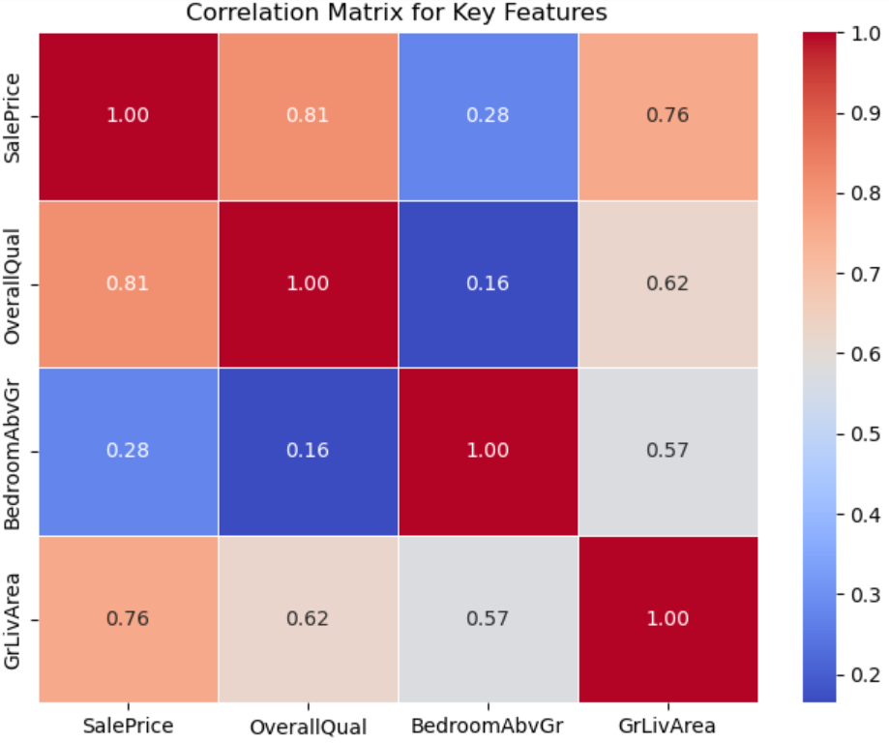
Correlation Analysis
Correlation Analysis is statistical method that is used to:
Discover if there is a relationship between two variables/datasets and how strong that relationship may be.
Heatmap visualization to show correlations
Helps in feature selection
Identify how features relate to each other

Slide 11
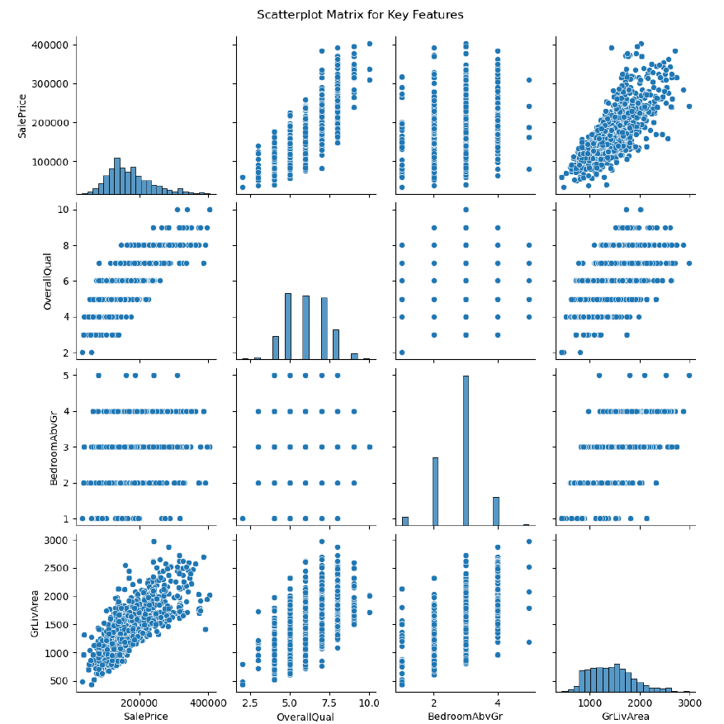
Feature Engineering
Feature engineering is the process of selecting, transforming, and creating new variables (features) from raw data to improve the performance of machine learning models. It involves transforming raw data into a format that is more suitable for machine learning algorithms. This can include handling missing data, encoding categorical variables, scaling numerical features, and creating new features by combining existing ones.

Slide 12
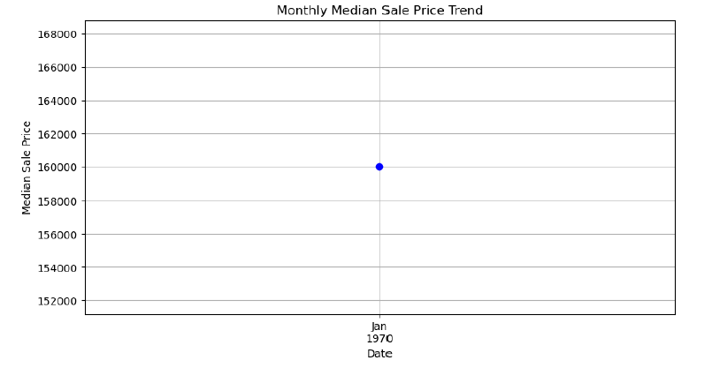
Monthly Median Sale Price Trend

Slide 13
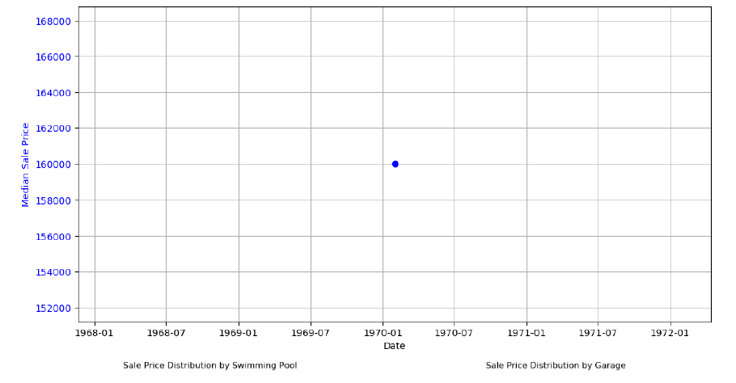
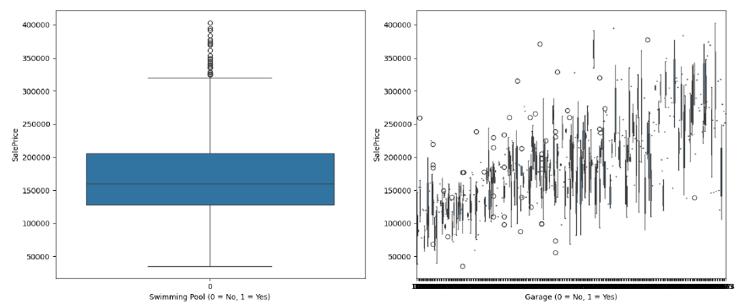
Sale Price Distribution by Swimming Pool and Garrage

Slide 14
Key Findings and Recommendations
Key Drivers: Size, Location, Amenities
Suggest feature-based pricing models
Recommend focusing on profitable clusters

Slide 15
Conclusion
EDA provided strategic insights
Helps optimize pricing and acquisition
Sets base for predictive modeling and dashboarding

